Slide 1

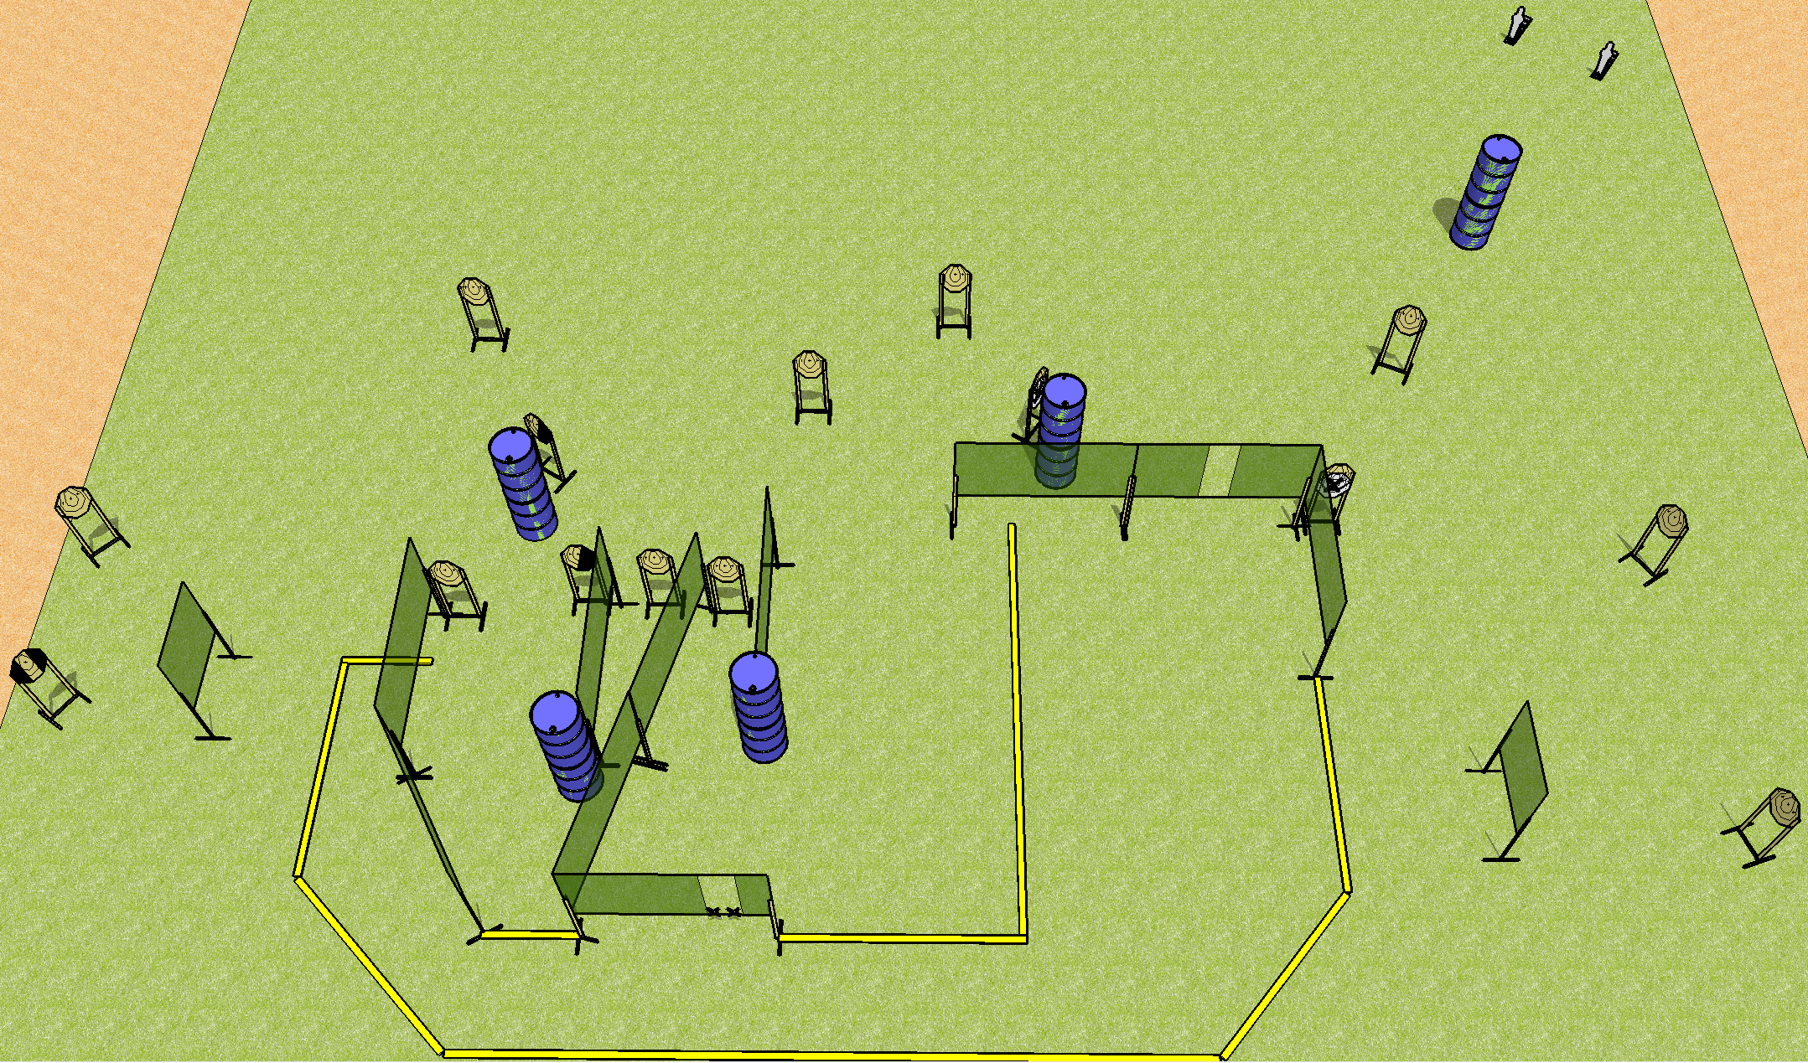
 | Dothan Practical Shooters – USPSA Match Fishhook Course Designer : Drew Coleman Bay: A2
Round Count 32 rounds 15 IPSC 2 mini poppers
Equipment List 21 wall feet

Slide 2
Fishhook
Written Stage Briefing
Scoring: Comstock Rounds: 32
Targets: 15 IPSC, 2 steel
Handgun start position: hands touching marks. Handgun is loaded and holstered.
PCC start position: stock on belt, muzzle touching either mark. Loaded carbine is held with both hands, safety on.
Stage Procedure: on the audible start signal, engage targets as they become available from within the shooting area.

